Slide 1
Recap: Integrated Healthcare for Co-Infections and Conditions
Integrated HIV and hypertension care that included persons without HIV improved population level health outcomes across communities in Kenya and Uganda
A nurse practitioner led program to treat MDR-TB was safe and effective in the eastern Cape in South Africa
Key population involvement, starting at the community level in program and research enables a more effective HIV response in Burundi

Slide 2
Recognize challenges and build on successes
Challenges
Successes
Inflexible health systems
Insufficient financial investment
Inadequate work force
Weak data and monitoring capacity
Low barrier testing+supportive linkage
Differentiated care + task shifting
Community engagement by and for vulnerable populations
Pilots that work
COVID-19

Slide 3
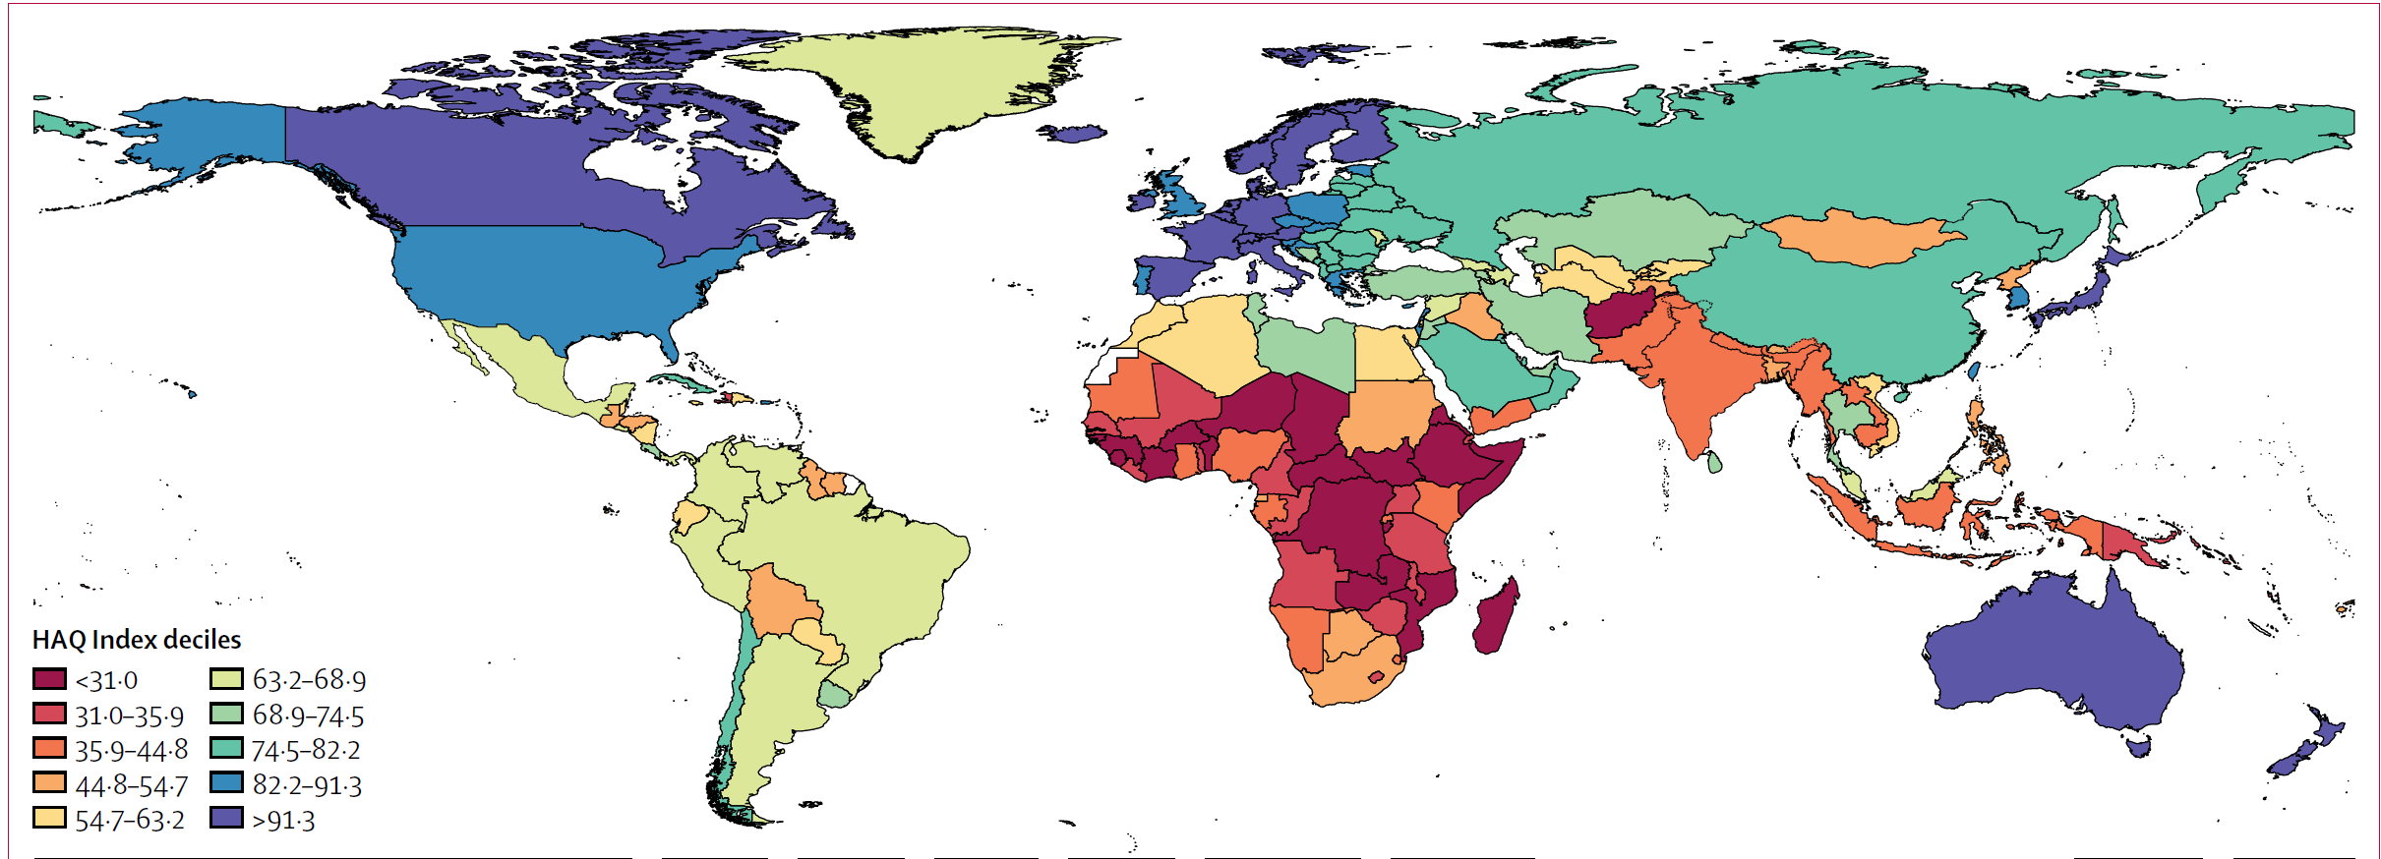
HIV community needs to lead the way to Quality Universal Health Care
Financial risk protection, access to quality essential health care services and access to safe, effective, quality and affordable essential medicines and vaccines for all
Sustainable Development Goal

Slide 4
Thank you!

